Slide 1
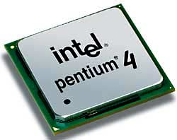
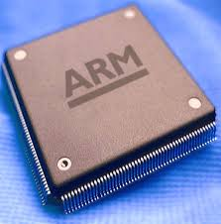
Microprocessors & Computer Architecture Unit-1 : Introduction Session -1 UE18CS253
Credits:
MPCA Team
SESSION JAN- MAY 2020
<number>
Notes:
<number>

Slide 2
Agenda
Part A – Theory
Preamble
Syllabus
Objective Lesson Plan
Part B – Laboratory
Problem Set
Programs to be executed in the lab
Mini Project
Conduction & Evaluation
SESSION JAN- MAY 2020
<number>
Notes:
<number>

Slide 3
Preamble
Motivation
a) Why do we need to Learn Microprocessors?
SESSION JAN- MAY 2020
<number>

Slide 4


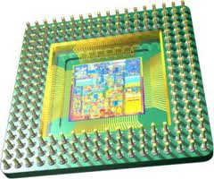

MICROPROCESSOR
Brain or Heart
Of a computer System???
Statutory Warning: does not resemble anyone over here
SESSION JAN- MAY 2020
<number>
Notes:
<number>

Slide 5
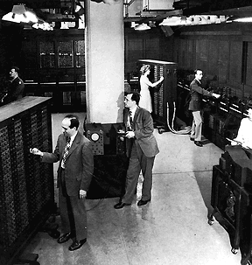
Microprocessor
A silicon chip that contains a CPU.
Three basic characteristics
differentiate microprocessors:
Instruction set: The set of instructions that the microprocessor can execute.
bandwidth : The number of bits processed in a single instruction.
clock speed : Given in megahertz (MHz), the clock speed determines how many instructions per second the processor can execute.
SESSION JAN- MAY 2020
<number>

Slide 6

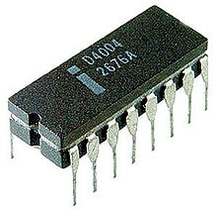
Who am I ???
The Intel 4004, generally regarded as the first microprocessor, and cost $60. The first known advertisement for the 4004 is dated November 15, 1971 and appeared in Electronic News. The project that produced the 4004 originated in 1969.
A 4 bit muP
SESSION JAN- MAY 2020
<number>
Notes:
<number>

Slide 7
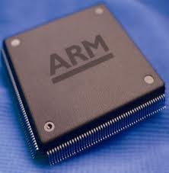
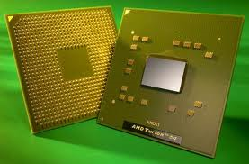
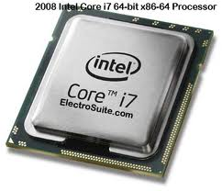

64 bit Microprocessors
SESSION JAN- MAY 2020
<number>

Slide 8
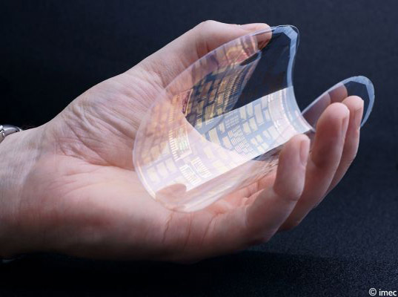
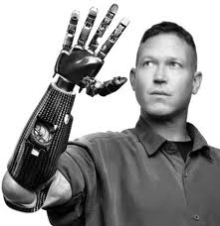
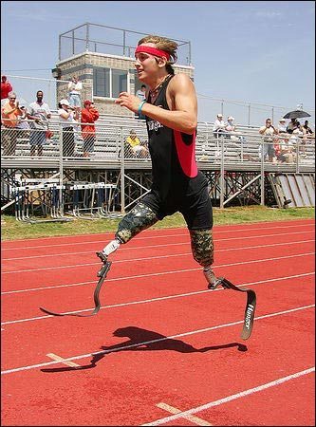
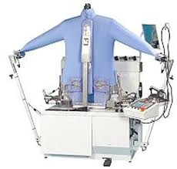
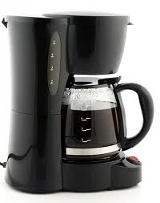
Why Study Microprocessor??
Because its part of the Curriculum!!! ☺
Everywhere we have devices which are controlled by “Microprocessor” or “Microcontroller”
SESSION JAN- MAY 2020
<number>

Slide 9

Man in the e-world!!!
SESSION JAN- MAY 2020
<number>

Slide 10
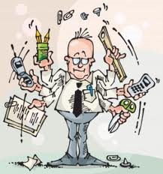
Or is it this ☺
SESSION JAN- MAY 2020
<number>

Slide 11
ARM Processor
ARM originally stood for Acorn RISC Machine
Motorola – 68,000 transistors, 16 bit chip
Intel 286 – 134,000 transistors, 16 bit chip
ARM2 - 30k transistors, 32 bit chip
Simple, fast, low power, cheap
Early years sold few thousand processors per year
Now about 5 billion per year
The first commercial RISC implementation
SESSION JAN- MAY 2020
<number>

Slide 12
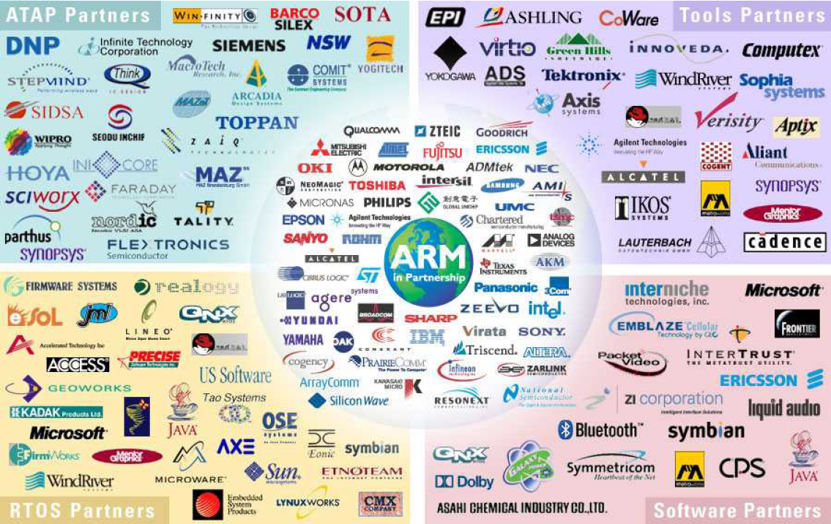
ARM Ltd
Design and license ARM core design but not fabricate
SESSION JAN- MAY 2020
<number>

Slide 13
Why ARM?
One of the most licensed and thus widespread processor cores in the world
Used in PDA, cell phones, multimedia players, handheld game console, digital TV and cameras
ARM7: GBA: Game Boy Advance- 32bit handheld videogame console, iPod
ARM9: NDS: Dual screen handheld game console.
PSP : Play Station Portable – Games , Sony Ericsson, BenQ
ARM11: Apple iPhone, Nokia N93, N800 : Tablet
75% of 32-bit embedded processors
Used especially in portable devices due to
Its low power consumption and
Reasonable performance
SESSION JAN- MAY 2020
<number>

Slide 14
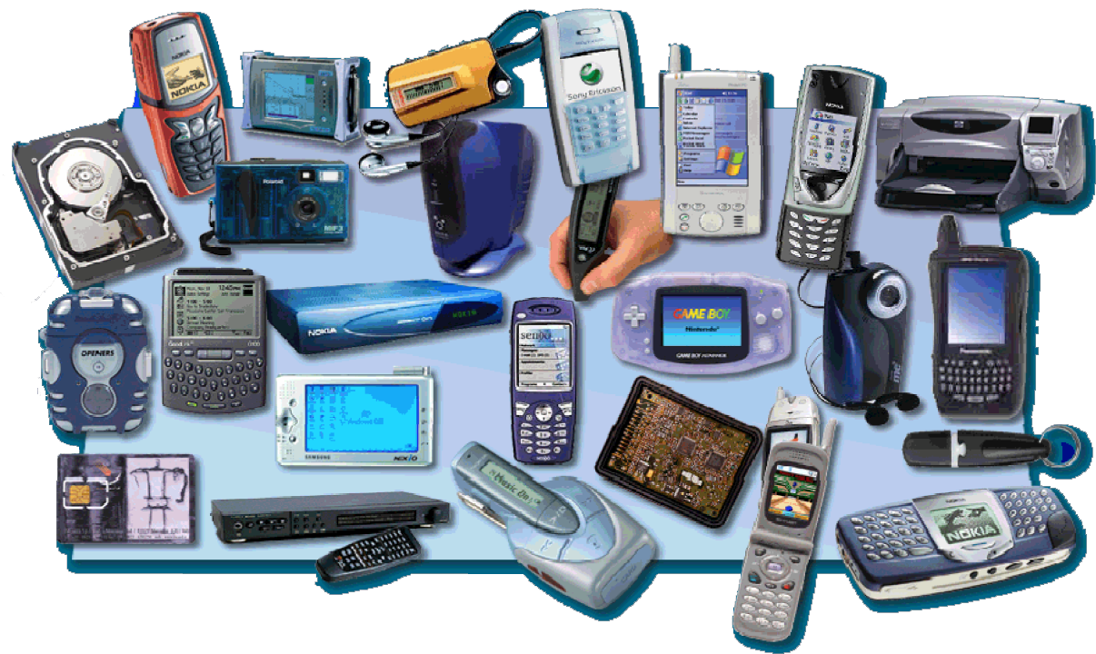
ARM powered products
SESSION JAN- MAY 2020
<number>

Slide 15
Objectives:
UE18CS253CObj1:
Introduce concepts of basic processor architecture and its design
UE18CS253CObj2:
Introduce concepts of pipeline architecture and hazards
UE18CS253CObj3:
Bring in the study of memory hierarchy, cache memory and its optimizations
UE18CS253CObj4:
Introduce multi core processor architecture and programming
SESSION JAN- MAY 2020
<number>

Slide 16
Outcomes:
UE18CS253CO1 | Demonstrate the ability to understand the design of different instruction sets like RISC/CISC and their addressing modes
UE18CS253CO2 | Demonstrate the ability to understand the design of a pipelined processor and its challenges
UE18CS253CO3 | Demonstrate the use of tools to analyse the performance of programs on different architectures
UE18CS253CO4 | design alternative memory hierarchy layouts and optimizationsde
UE18CS253CO5 | Demonstrate and appreciate modern trends in architecture such as multicore architectures
SESSION JAN- MAY 2020
<number>

Slide 17
Part B: UE18CS257: MPCA Laboratory
Problem Set
Programs to be executed in the lab
Mini Project
Conduction & Evaluation
SESSION JAN- MAY 2020
<number>
Notes:
<number>

Slide 18
Part B- Laboratory
Conduction and Evaluation
Every problem statement given has to be executed in the regular lab.
Project may be to demonstrate the knowledge and usage of Microprocessors.
Project team size may be a maximum of 3.
Weekly review & evaluation for all teams during lab # 9 to 12.
ISA is done as follows.
Programs 1 to 8 are executed during regular labs and evaluated for 25 marks.
Regular Lab execution evaluated for 25 marks
Observation : 10 marks
Viva Voce : 05 marks
b. Mini project : To be evaluated for 20 marks in the 9 to 12 lab
c. Theory Assignment : 10 marks
SESSION JAN- MAY 2020
<number>
Notes:
<number>

Slide 19
Part B: Laboratory
Mini Projects
SESSION JAN- MAY 2020
<number>
Notes:
<number>

Slide 20
Syllabus - Theory & Laboratory
Course Information
Deliberations
SESSION JAN- MAY 2020
<number>
Notes:
<number>

Slide 21
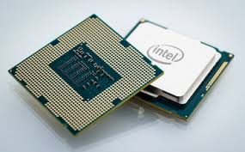
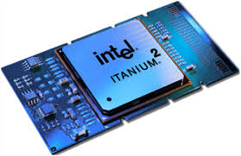
Agenda
Computer Organization
Computer Architecture
Microprocessor
MP - Evolution
Microcontroller
Summary
SESSION JAN- MAY 2020
<number>

Slide 22
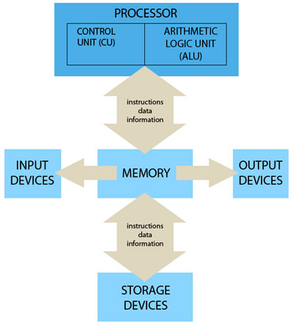
Computer Organization
Computer Organization refers to the Operational Units and there interconnections that realize or recognize the specifications of Computer Architecture.
Organizational attributes includes Hardware details transparent to the programmer such as control signals , Interface between computers and peripherals and the memory technology used.
SESSION JAN- MAY 2020
<number>

Slide 23
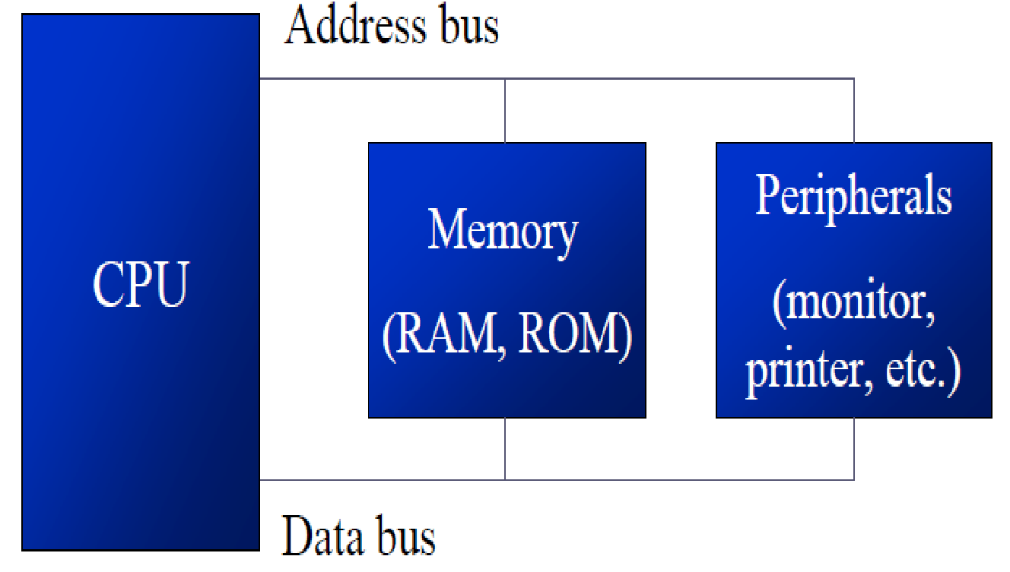
Computer Architecture
Computer Architecture refers to those attributes of a system visible to a programmer, the other way those attributes that have direct impact on the logical execution of the program.
Architectural attributes include the instruction set, the no of bits used to represent the data types, Input Output mechanism and technique for addressing memories.
SESSION JAN- MAY 2020
<number>

Slide 24

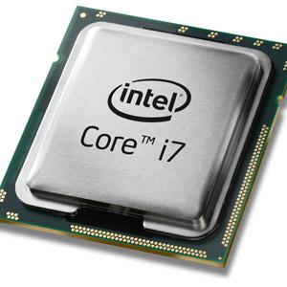
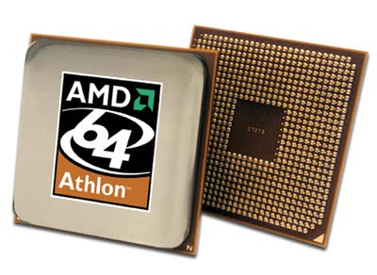
Microprocessor
A microprocessor is a computer processor that incorporates the functions of a computer's central processing unit (CPU) on a single integrated circuit (IC).
Multi purpose programmable device.
Accepts digital data as input, processes it according to instructions stored in its memory, and provides results as output.
Brain of the computer.
Multiple microprocessors, working together, are the "hearts" of datacenters, super-computers, communications products, and other digital devices.
Don’t have RAM, ROM, and other peripheral on the chip
Desktop PC’s, Laptops, notepads .
Intel’s Pentium 1,2,3,4, core 2 duo, i3, i5 etc
SESSION JAN- MAY 2020
<number>
Notes:
<number>

Slide 25
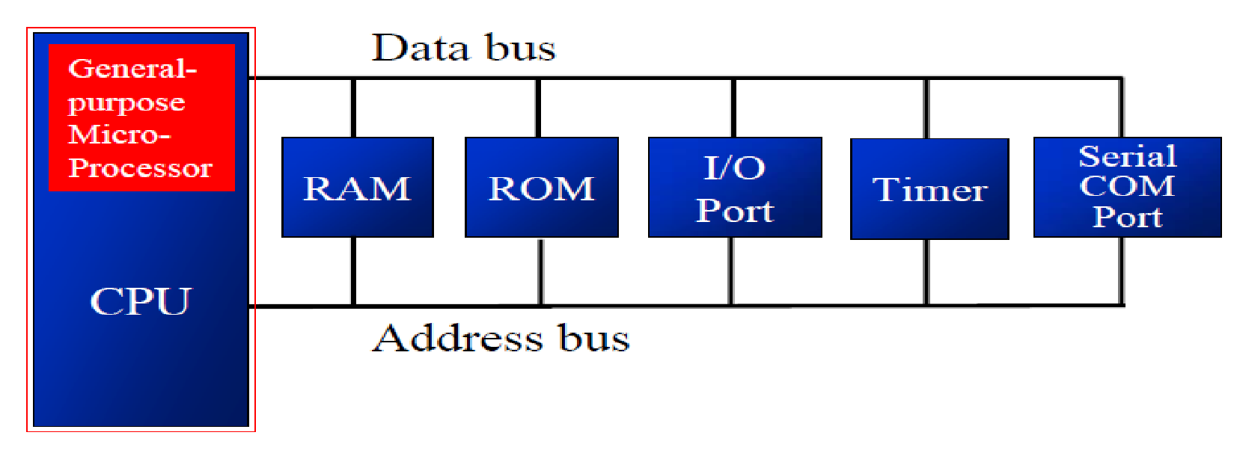
Microprocessor
Memory , I/O and other components have to be connected externally.
Cannot be used in compact systems.
Power Consumption is High.
Has less number of registers, hence more operations are memory based.
SESSION JAN- MAY 2020
<number>

Slide 26
Microprocessor - Evolution
YEAR | NAME | BIT SIZE
1971 | 4004 | 4
1972 / 74 / 77 | 8008 / 8080 / 8085 | 8
1978 / 79 | 8086 / 8088 | 16
1982 / 85 / 89 | 80286 / 386 / 486 | 32
1993 / 95 / 97 | 80586 (Pentinum) / Pro / P=II | 32
1999 | Ecleron and Pentinum III | 32
2000 | Pentinum IV | 32
2001 | Intanium | 64
2003 | Pentinum M processor | 64
2005 | Pentinum IV and Xeon | 64
SESSION JAN- MAY 2020
<number>

Slide 27
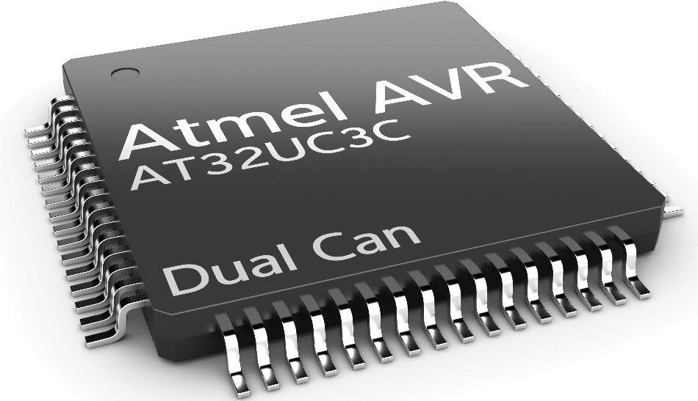
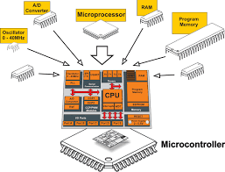
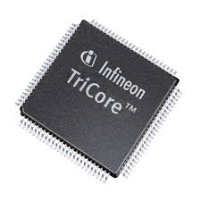
Microcontroller
Microcontroller has a CPU, in addition with a fixed amount of RAM, ROM and other peripherals all embedded on a single chip.
Also termed as a mini computer or a computer on a single chip.
Designed to perform specific tasks.
Requires small resources like RAM, ROM, I/O ports etc. and hence can be embedded on a single chip.
Reduces the size and the cost.
Applications : Washing machine, Digicam, Pendrive, Remote, Microwave, Cars, Bikes, Telephone, Mobiles, Watches, etc.
Manufacturers : ATMEL, Microchip, Texas Ins., Freescale, Philips, Motorola etc.,
SESSION JAN- MAY 2020
<number>

Slide 28
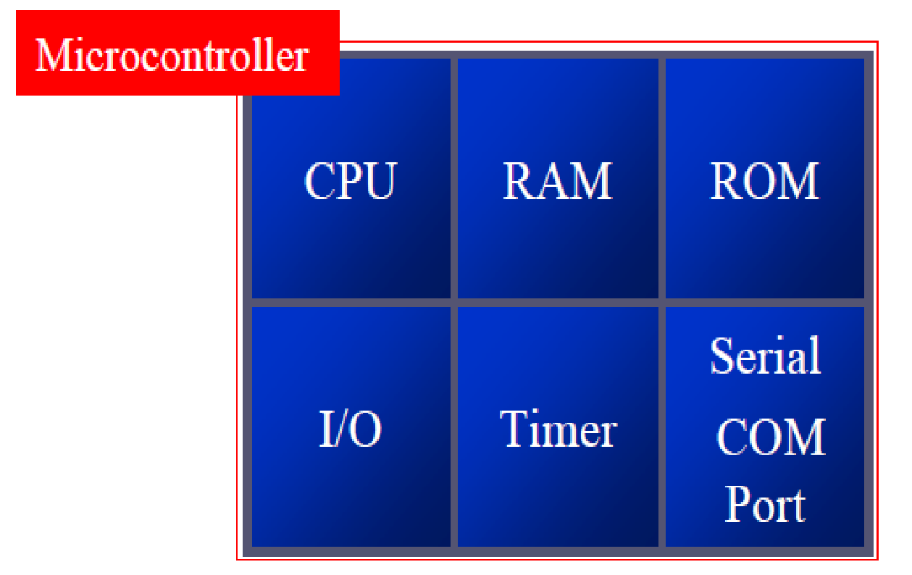
Microcontroller
Has Processor, Memory with Input / Output components connected internally.
Can be used in compact systems.
External components are low, total power consumption is less.
Has more number of registers, hence the programs are easier to write.
SESSION JAN- MAY 2020
<number>
Notes:
<number>

Slide 29

SESSION JAN- MAY 2020
<number>

